Slide 1
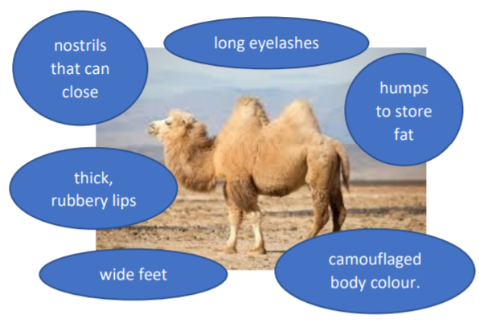
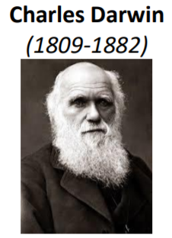
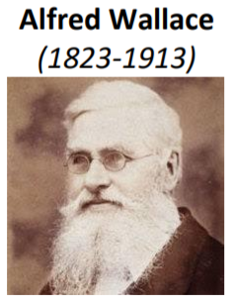
Year 6 Evolution and inheritance
Evolution
Adaptation can lead to evolution if the environment changes. Animals and plants with variations that are best suited survive in greater numbers to reproduce and pass their characteristics on to their young. This is natural selection. Over time these inherited characteristics become more dominant within the population.
Key Vocabulary
Evolution – the process by which different kinds of living organisms are believed to have developed from earlier forms during the history of the earth
Adapted – animals and plants are adapted to their environment. Their bodies are suited to the way they live.
Environment – the surroundings or conditions in which a person, animal or plant lives
Inherited – the way a trait or characteristic is passed to offspring from parents.
Vary - A change or small difference.
Offspring - a person’s/animal’s child or children
Breeding – the mating and production of offspring by animals
Fossils – preserved remains of a living thing from the past.
Characteristics - a distinguishing trait, feature or quality.
Adaptation
Plants and animals have characteristics that make them suited to their environment. E.g. camel:
Famous Scientists
Charles Robert Darwin was born in Shrewsbury and was an English naturalist and biologist. His scientific theory of evolution by natural selection became the foundation of modern evolutionary studies.
Alfred Russel Wallace was an explorer, naturalist and anthropologist. He independently proposed the theory of evolution by natural selection. He worked around the world gathering evidence to support his theory
Fossils

