Slide 1
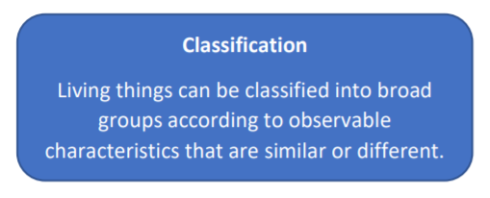
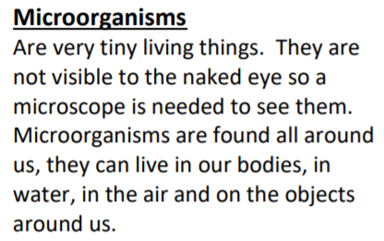
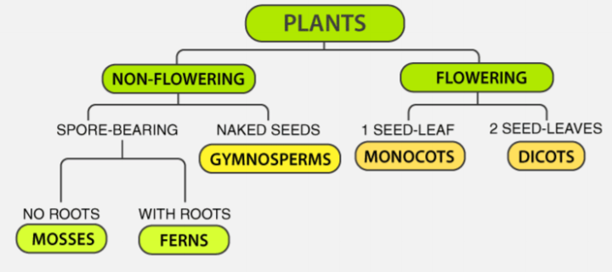
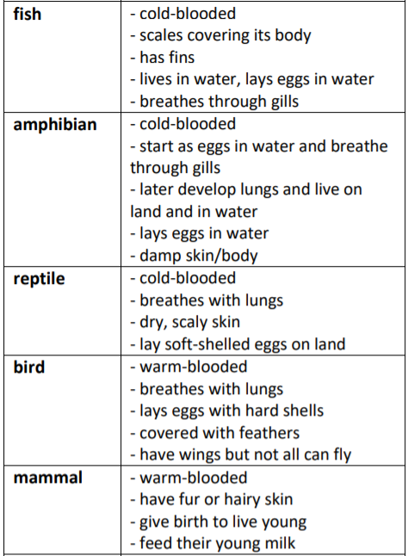
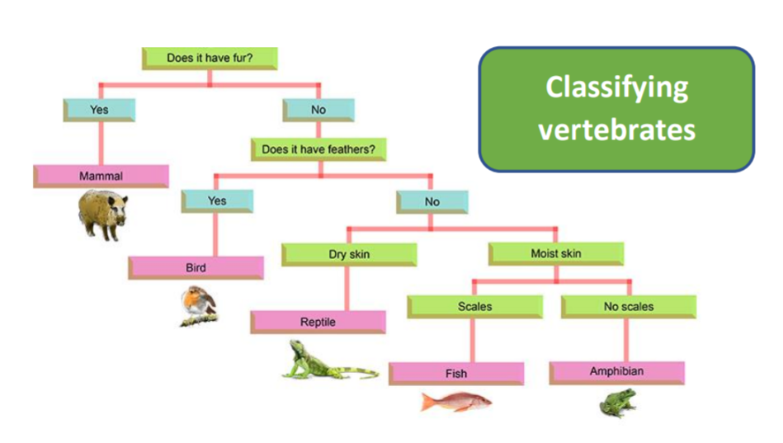
Key Vocabulary
Vertebrate – animals which have a backbone/spine
Invertebrate – animals which do not have a backbone/spine
Plants - can make their own food. They can be divided broadly into two main groups: flowering plants and nonflowering plants
Year 6 Living things and their habitats
Classifying Plants
Flowering plants – numerous and diverse group. Reproduce through flowers and seeds. E.g. sunflower
Non-flowering plants – smaller group. They have a simple structure and do not have flowers or seeds. They reproduce through spores. E.g. algae, mosses

