Slide 1
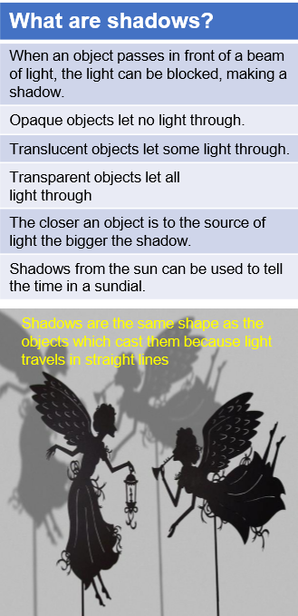
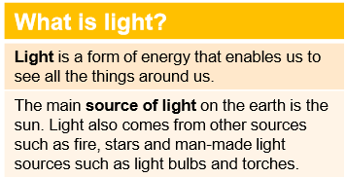
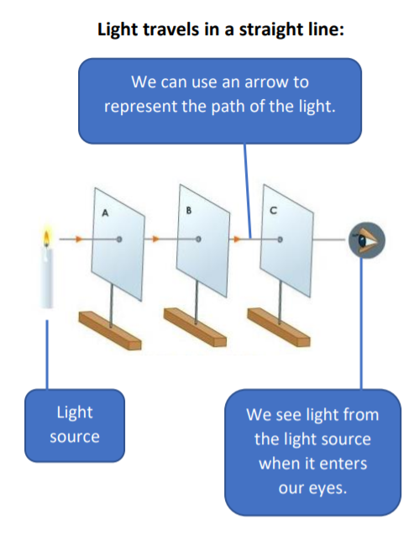
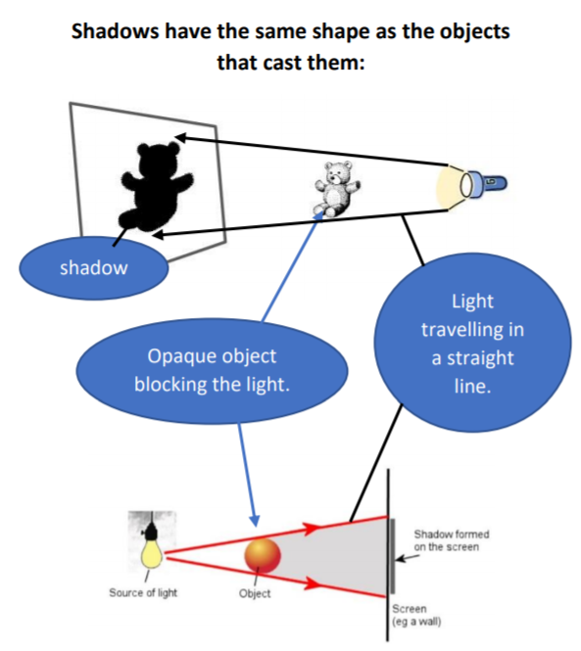
Key Vocabulary
Light source - a natural or artificial source of light.
Straight lines - light travels in straight lines. light ray Each line of light travelling in a straight line from its place of origin.
Reflect - to throw back light from a surface.
Shadow – a dark area created where light from a light source is blocked by an object. The object blocking the light will be opaque or translucent.
Year 6 Light

