Slide 1
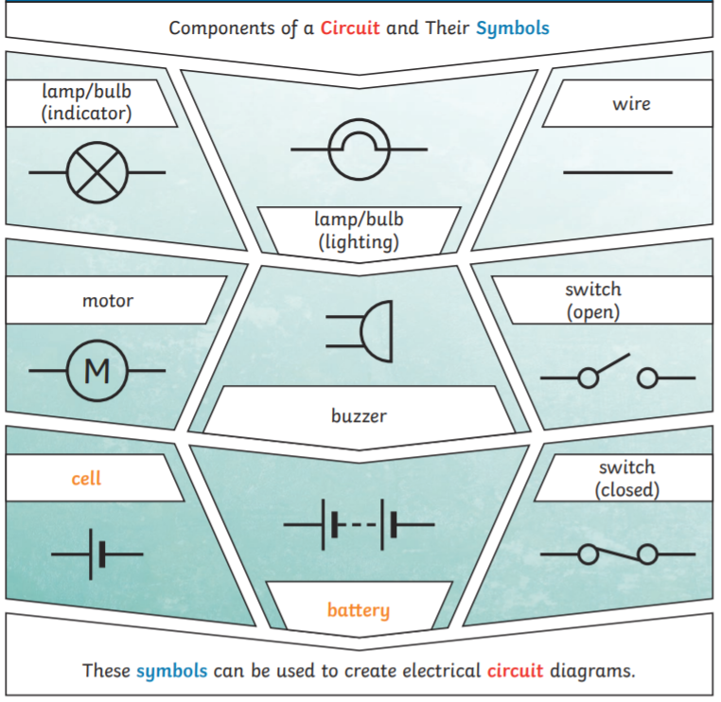
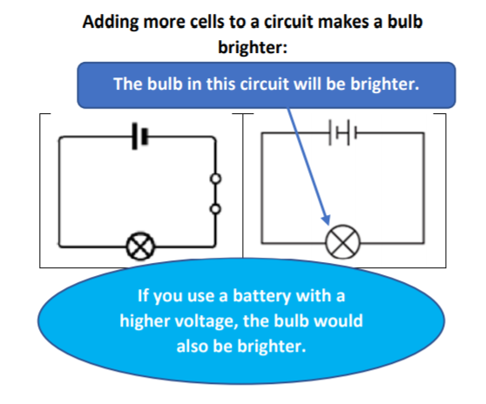
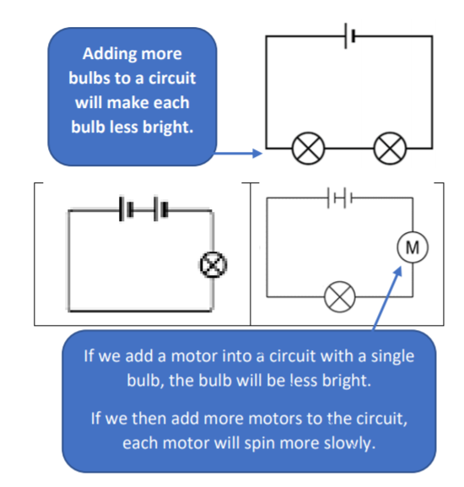
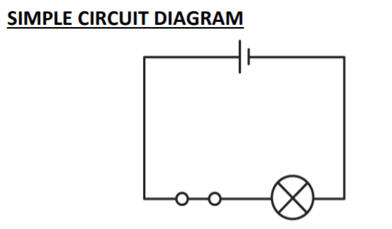
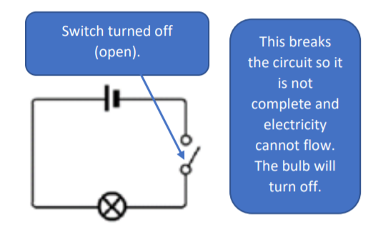
Year 6 Electricity
Key Vocabulary
Circuit – a complete route which an electrical current can flow around Wire – a long, thin piece of metal that carries electrical current
Buzzer – an electrical device that makes a buzzing sound Bulb – an electrical device that lights up
Motor – a device that makes movement
Switch – a component that can turn the electrical device on or off.
Cell – a device used to generate electricity, a battery is an example of this.
Voltage - An electrical force that makes electricity move through a wire, measured in volts (V)
Current – the flow of electricity through a wire

