Slide 1
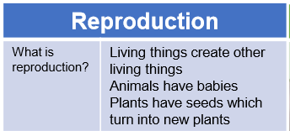
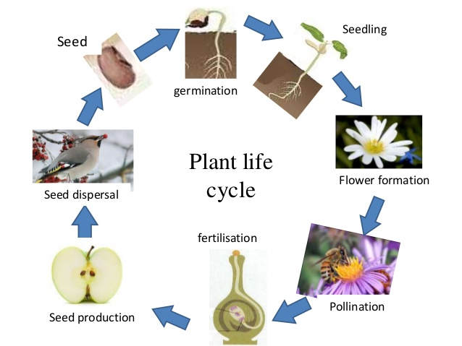
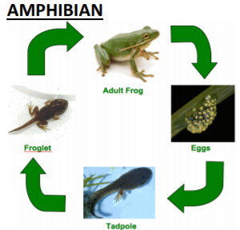
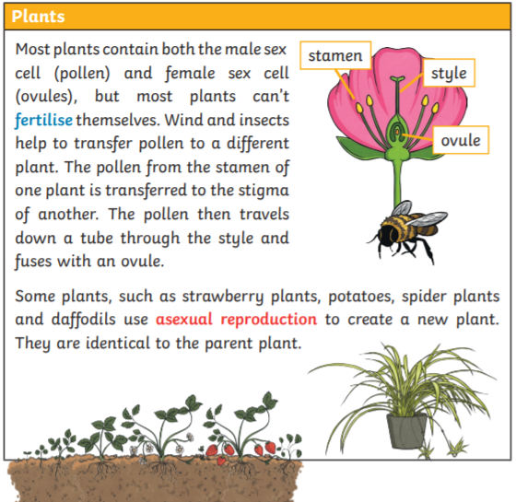
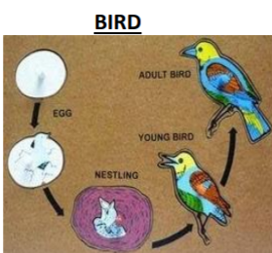
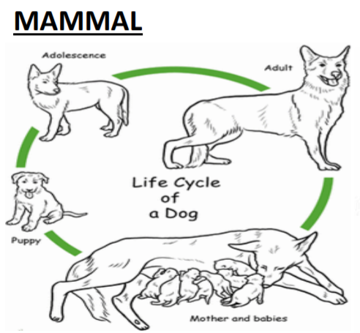
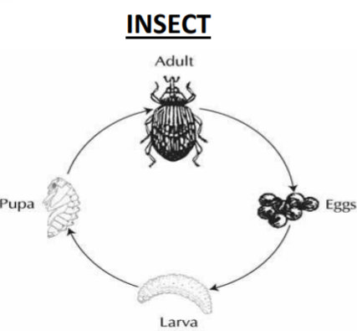
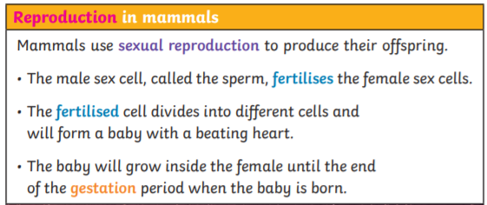
Key Vocabulary
Life cycle – the stages a living thing goes through in its life
Reproduction – the process by which a living organism creates a likeness to itself
Asexual reproduction – offspring gets genes from one parent so they are clones of their parents
Sexual reproduction – offspring get genes from both parents so they inherit a mix of features from both
Fertilise – The action of fusing the male and female sex cells in order to develop an egg
Metamorphosis – and abrupt and obvious change in the structure of an animals body and their behaviour
Year 5 Living things and their habitats
Life cycles

