Slide 1
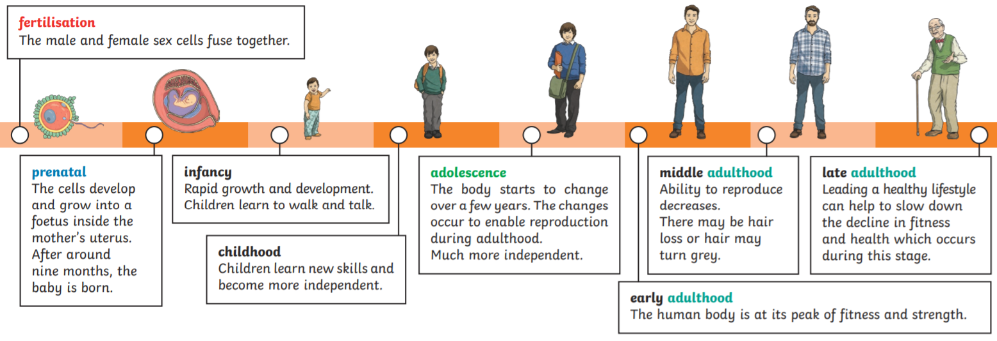
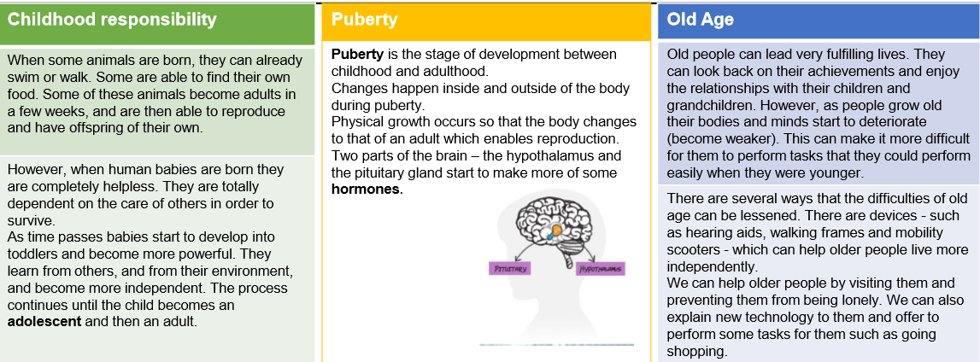
Year 5 Animals including humans
Key Vocabulary
Embryo - A newly fertilised egg in the womb.
Foetus - An unborn baby that has developed from an embryo.
Childhood - the age span ranging from birth to adolescence.
Adolescence -The time when a child develops into an adult.
Puberty - The time during which adolescents reach sexual maturity and become capable of reproduction.
Hormones - Substances in our blood that influence our mood or behaviour.
Life span - The length of time something lives for.
Reproduction - The biological process by which new individual organisms – "offspring" – are produced from their "parents".

