Slide 1
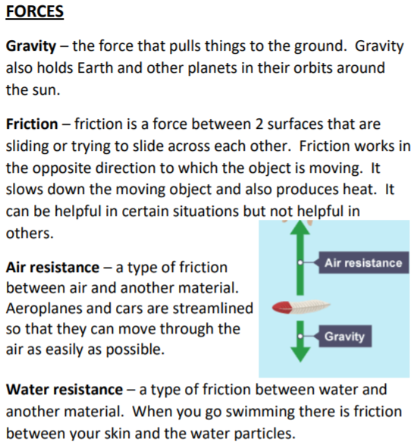
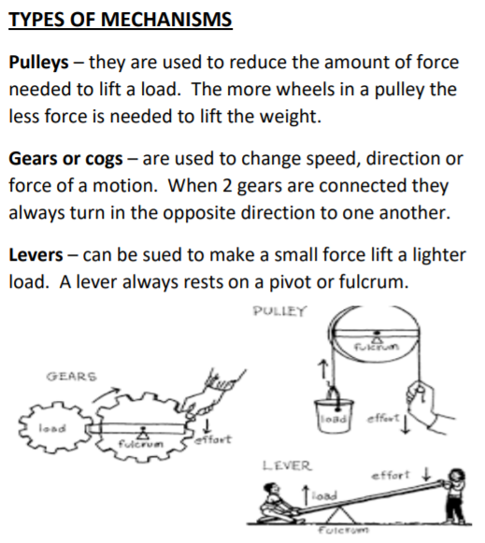
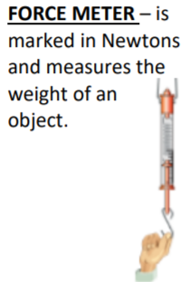
Key Vocabulary
Force - A force is a push or a pull. Forces make objects start moving, stop moving, speed up, slow down or change direction.
Gravity - A force which pulls things down towards the centre of the Earth.
Newton (N) - The unit for measuring force.
Air resistance - The force that slows down objects that move through air.
Water resistance - A force that slows down objects moving through water.
Friction - When one surface moves against another, the rubbing force that tries to stop them is called friction. It gives us grip.
Mechanisms - A device that allows a small force to be increased to a larger force.
Simple machines - Levers, pulleys and gears are all types of simple machines
Year 5 Forces

