Slide 1
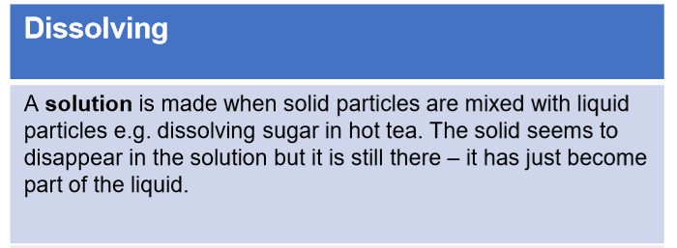
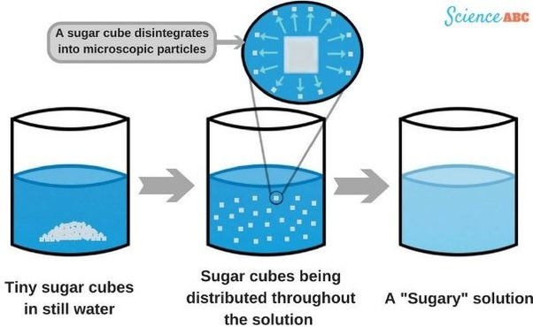
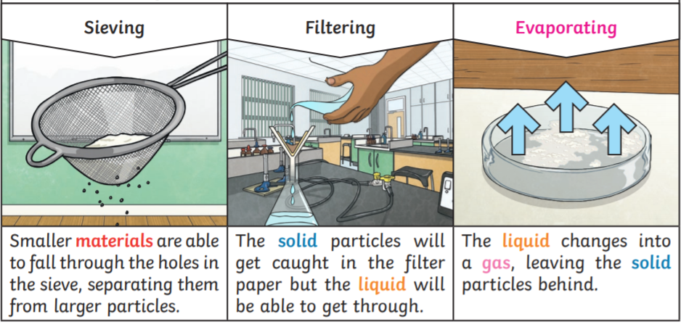
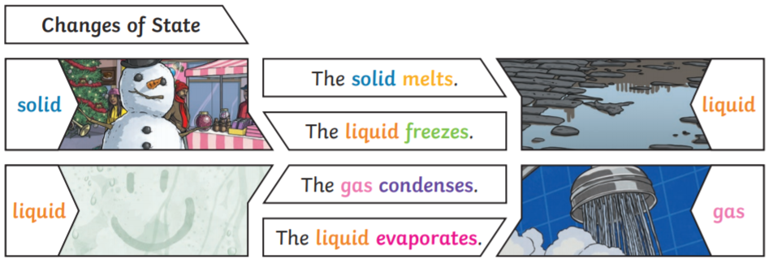
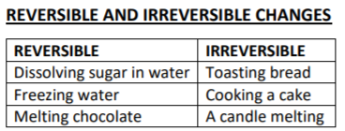
Year 5 Properties and changes of materials
Key Vocabulary
Thermal conductor - a material or device which allows heat to carry through
Electrical conductor – a material or device with allows electricity to carry through
Soluble – able to be dissolved, especially in water
Insoluble – cannot be dissolved, especially in water
Dissolve – when something solid mixes with a liquid and becomes part of the liquid
Solution – is made when one substance dissolves into another
Reversible change – can be reversed back to its original state
Irreversible change – cannot be reversed back to its original state
Materials
Different materials are used for different jobs based on their properties:
Electrical conductivity
Flexibility
Hardness
Insulators
Magnetism
Solubility
Thermal conductivity
Transparency
e.g. Glass is used for windows because it is hard and transparent.

