Slide 1
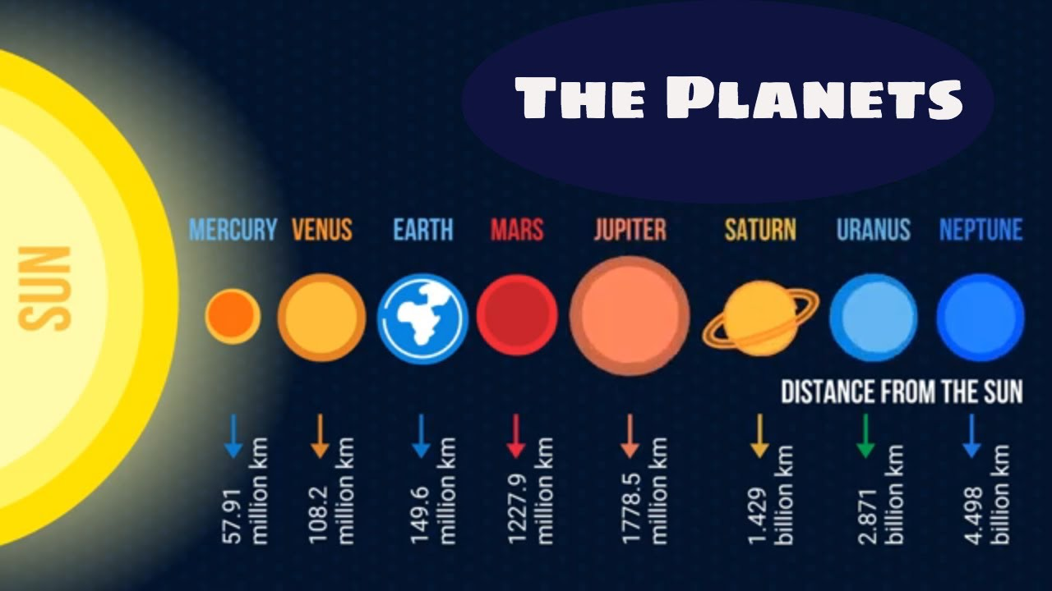
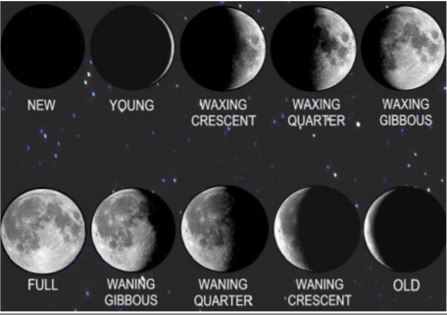
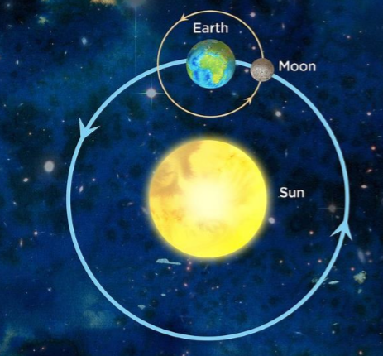
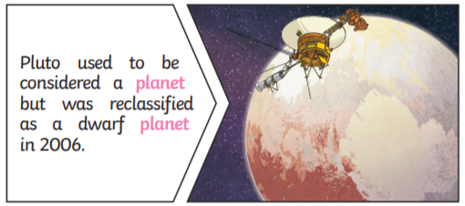
Key Vocabulary
Planet – an object that orbits a star and does not emit its own light
Star – a burning mass of gas that makes heat and light energy (e.g. the sun)
Sun – a huge star that earth and the other planets in our solar system orbit around
Moon – a natural satellite which orbits earth or other planets
Solar system – a star with objects (such as planets) orbiting it
Orbit – a curved path of a planet or satellite around an object
Sphere – a round 3D shape in the shape of a ball
Spherical bodies – astronomical objects shaped like spheres
Year 5 Earth and Space
The Earth
Earth takes 365¼ days to complete its orbit around the Sun. The Earth rotates (spins) on its axis every 24 hours. As Earth rotates half faces the Sun (day) and half is facing away from the Sun (night). As the Earth rotates, the Sun appears to move across the sky.
The Moon
The Moon orbits the Earth anticlockwise and takes approximately 28 days.
The Moon spins once on its axis every time it orbits Earth. This means that we only see one side of the Moon.
The Moon has different phases depending on where it is in its orbit. The Moon’s gravity causes high and low tides.
Moon Phases

