Slide 1
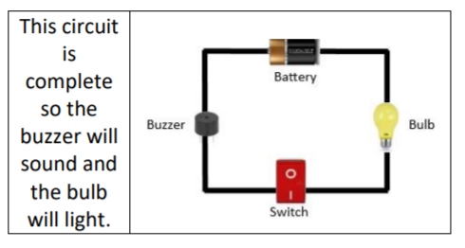
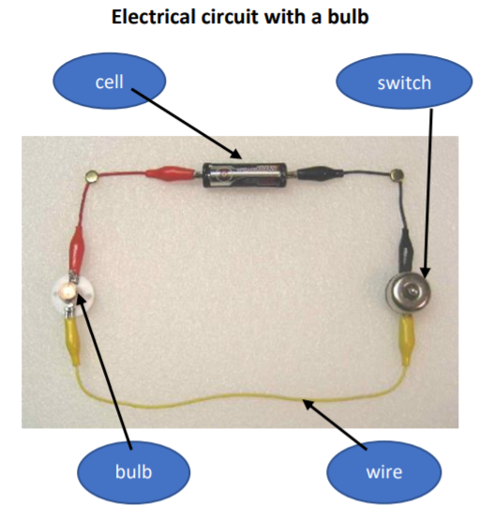
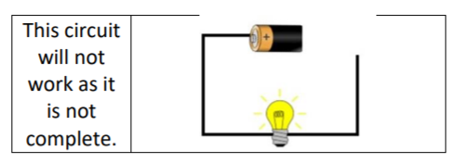
Year 4 Electricity
Key Vocabulary
Electricity - a form of energy used for lighting, heating, making sound and making machines work.
Electrical appliance - a machine or device that runs on electricity.
Circuit – a complete route which an electrical current can flow around
Mains - the electricity supplied to households from power stations.
Wire – a long, thin piece of metal that carries electrical current
Switch – a component that can turn the electrical device on or off.
Cell – a device used to generate electricity, a battery is an example of this.
Electrical Conductor – a material/device which allows electricity to pass through
Electrical Insulator – a material/device which does not allow electricity to pass through

