Slide 1
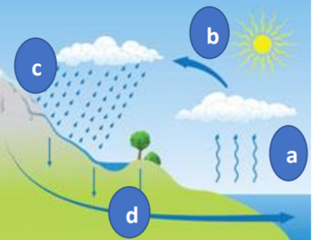
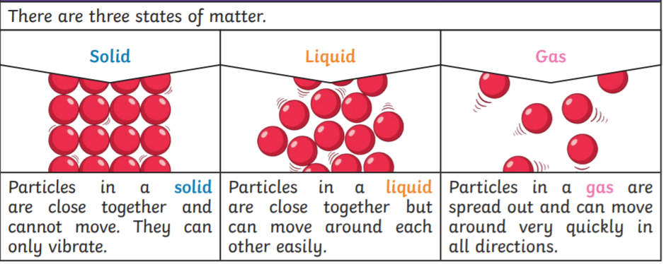
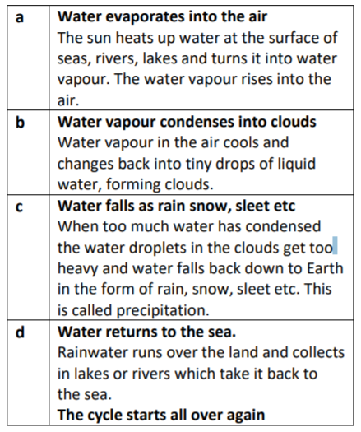
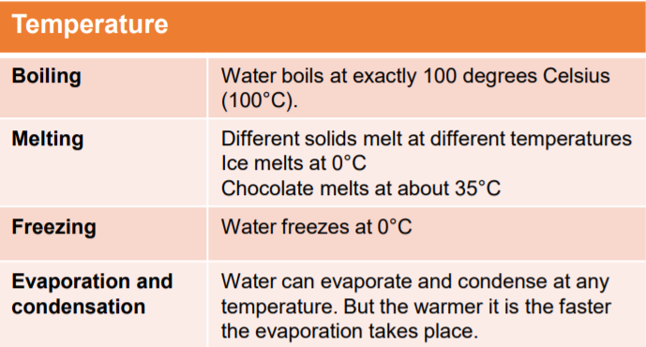
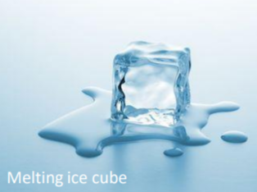
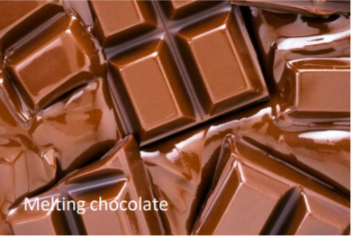
Year 4 States of matter
Key Vocabulary
Change of state - when a material changes from one state to another.
Melting – a solid changing into a liquid. freezing When a liquid becomes cold enough to turn solid, it freezes.
Melting point - the temperature at which a solid becomes a liquid.
Boiling point - the temperature at which a liquid turns into a gas.
Evaporation - when liquid changes into a gas.
Condensation - the process when a gas changes into a liquid, caused by cooling.
Water cycle - the never-ending process of water moving from the oceans, up into the atmosphere, and back to the Earth and oceans.
Temperature - the measure of how hot or cold something is.

