Slide 1
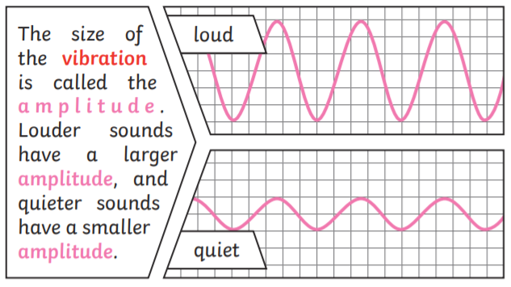
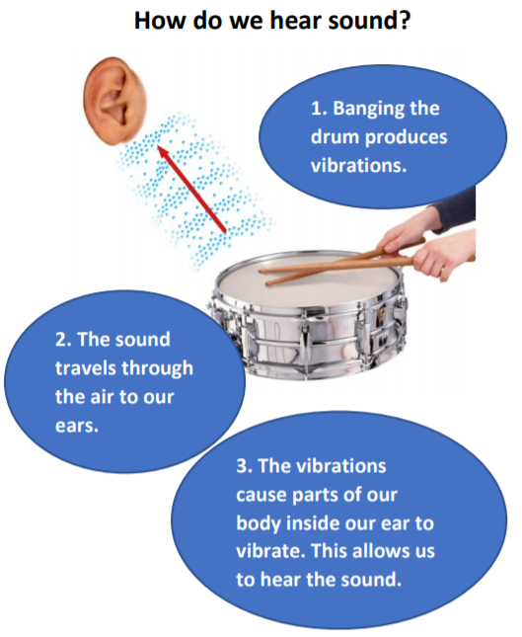
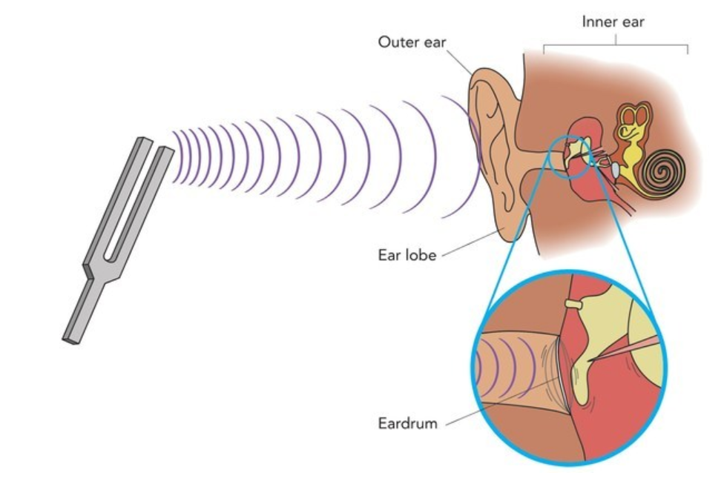
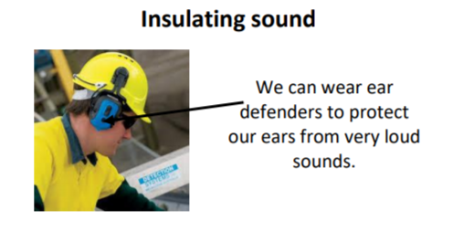
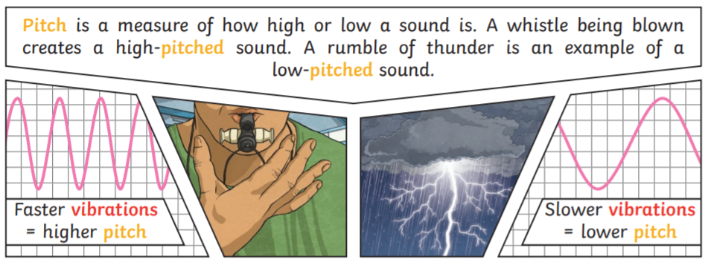
Key Vocabulary
Vibrations – moving (wobbling) very quickly back and forth.
Pitch – how high or low a sound is
Volume – how loud or quiet a sound is
Faint – barely hear something
Insulation - material that is used to stop heat, sound, or electricity from escaping or entering.
Soundproofing – a way to reduce the movement of sound.
Sound wave – how sound/vibrations travel through the air.
Year 4 Sound
Volume
Sound
Sound is a type of energy. Sounds are created by vibrations. The louder the sound, the bigger the vibration.
Pitch

