Slide 1
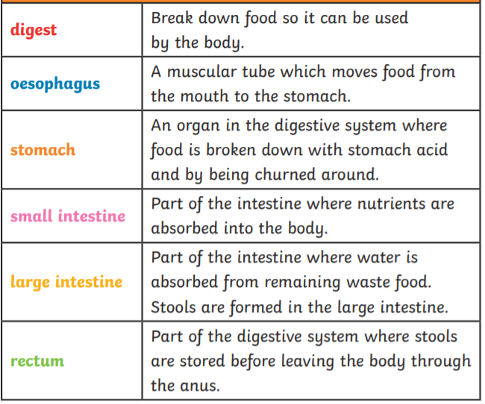
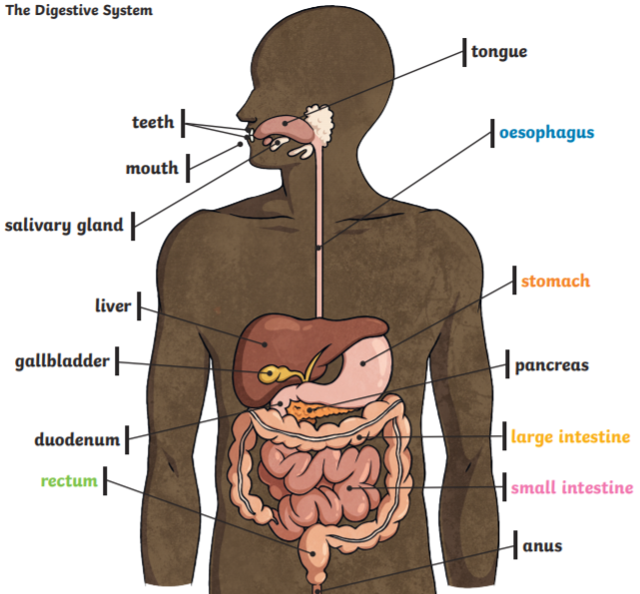
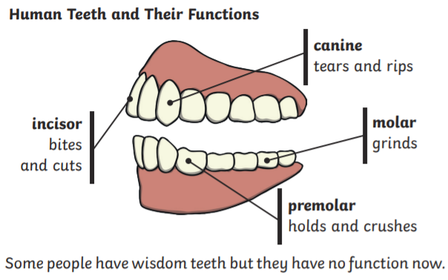
Key Vocabulary
Digestion – breaking down ingested food material.
Food chain – shows how plants and animals get their energy.
Producer – the start of a food chain and an organism that makes its own food (normally a plant)
Consumer – a living thing that eats other plants and animals.
Predator – an animal that eats other animals.
Prey – the animals that predators eat.
Energy – is strength and power, enables us to do the things we do.
Calcium – a chemical that helps keep your teeth strong.
Canine, incisor and molar – different types of teeth.
Year 4 Animals including humans
The Digestive System
Many organs are involved in the process of digestion which softens food so that it can pass through the body. As it moves through the body the nutrients which are required to keep us healthy and have energy are absorbed into the body.

