Slide 1
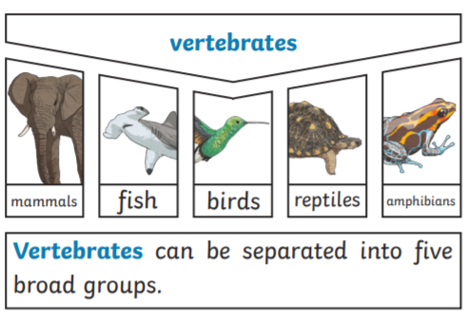
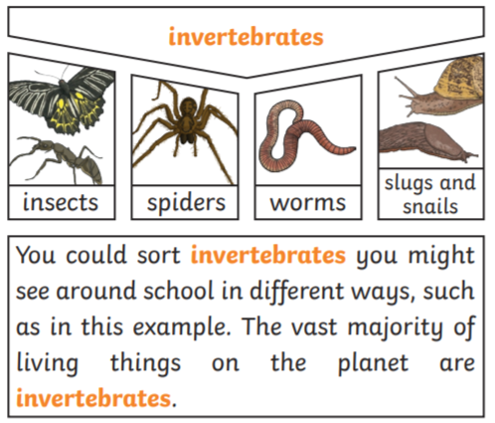
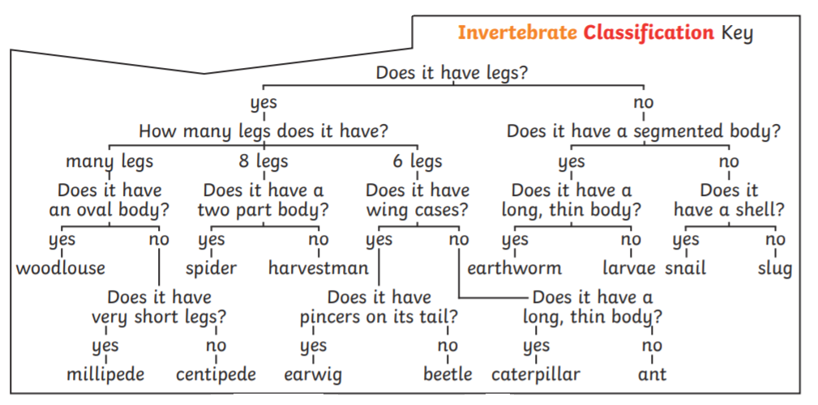
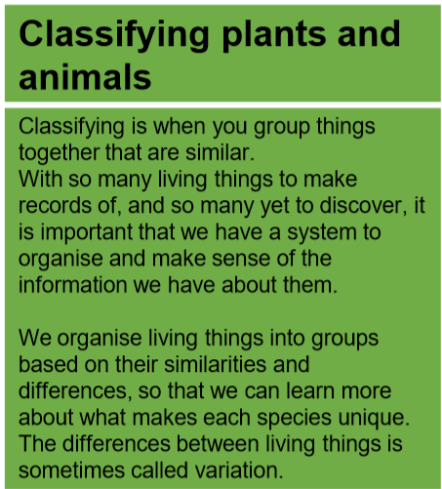
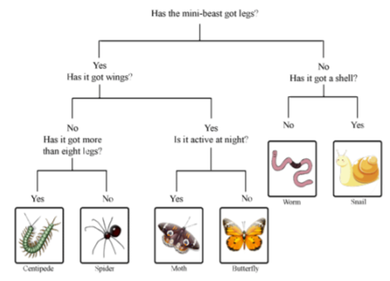
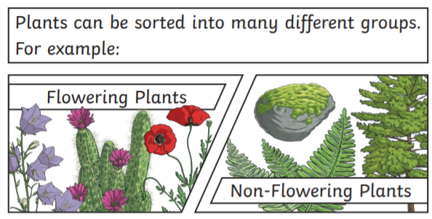
Key Vocabulary
Vertebrate – animals which have a backbone/spine
Invertebrate – animals which do not have a backbone/spine
Classification – grouping living things by looking at similarities and differences
Habitat – where a plant or animal lives
Hibernate – where a plant or animal spends the winter in a dormant state.
Environment – the surroundings or conditions in which an animal or plant lives
Deforestation – the action of clearing a wide area of trees
Endangered species – A plant or animal where there are not many left and scientists are concerned that the species may become extinct.
Year 4 Living things and their environments
Classification keys
You can use classification keys to help group, identify and name a variety of living things. Here is are some examples:
Characteristics of living things
All living things do these 7 life processes:
MRS GREN
Movement – moving, can be fast and obvious or slow and over time
Respiration – releasing energy from food
Sensitivity – responding to their environment
Growth – getting bigger and older
Reproduction – producing offspring
Excretion – getting rid of waste
Nutrition – taking in food

