Slide 1
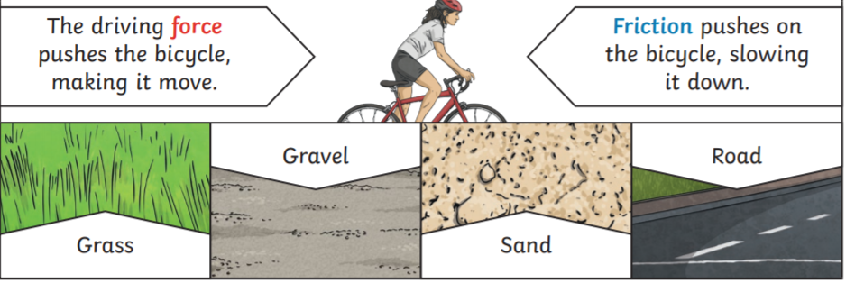
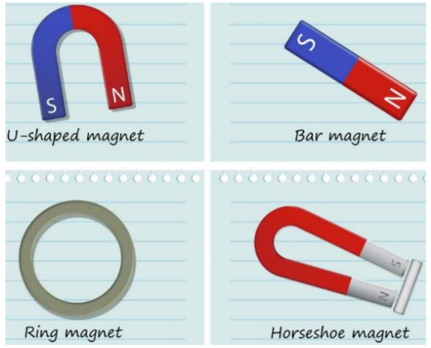
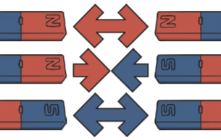
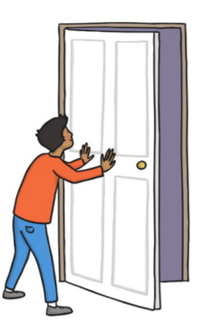
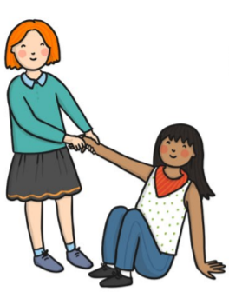
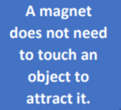
Key Vocabulary
Force – A push or a pull
Magnet – An object that produces a magnetic force which pulls something towards it
Magnetic – objects which are attracted to a magnet are magnetic. Objects containing iron, nickel or cobalt are magnetic
Magnetic force - The area around a magnet where there is a magnetic force which will pull magnetic objects towards the magnet.
Poles – 2 sides of a magnet where the magnetism is strongest
Attract – to pull towards (opposite of repel) Repel – To push away (the opposite of attract)
Friction- a force that acts between 2 surfaces or objects that are moving or trying to move, across each other.
Year 3 Forces and magnets
Magnetic materials
Forces
Different surfaces create different amounts of friction. The amount of friction created by an object moving over a surface depends on the roughness of the surface and the object, and the force between them.
Sorting magnetic materials
Magnets
Magnets are objects or materials that produce a magnetic field and attract or repel magnetic objects.
Magnets have two poles- A north pole and a south pole.
Like poles repel.
Opposite poles attract.
Forces will change the motion of an object. They will either make it start to move, speed up, slow down or even make it stop.
Push Pull

