Slide 1
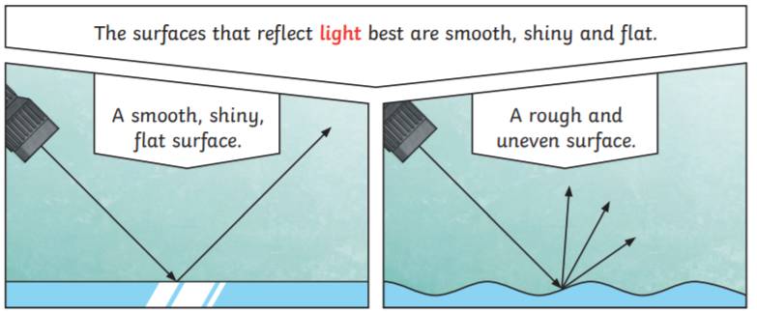
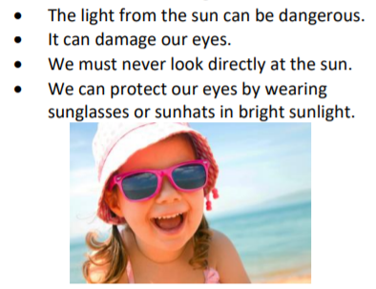
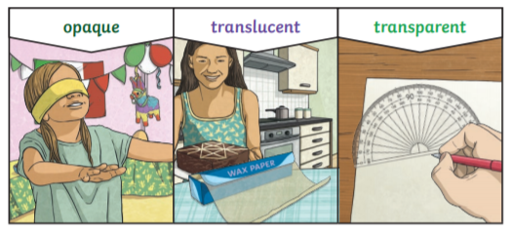
Key Vocabulary
Light – a form of energy that travels in a wave from a source
Light Source – an object that emits its own light
Dark – dark is the absence of light
Opaque – a material which light cannot pass through at all.
Transparent – a material through which light can pass completely. They are also called see-through objects.
Translucent – a material through which light can pass partially, we can partly see through these objects.
Reflects – when a light ray hits a surface and bounces off
Shadow - a dark shape that appears on a surface when something stands between the light source and the surface
Year 3 Light
Reflection
When light hits an object it is reflected (bounces off). If the reflected light hits our eyes, we can see the object. Some surfaces and material reflect light well and some do not reflect light well.
Shadows
When light is blocked by an opaque object a dark shadow is formed.
The size of the shadow changes as the light source moves, the further away from the light source the smaller the shadow is and the closer the light source is to the object the bigger the shadow. The angle of the light source also makes a difference to the size of the shadow.
The sun

