Slide 1
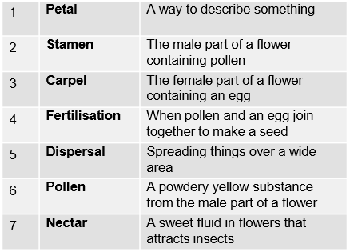
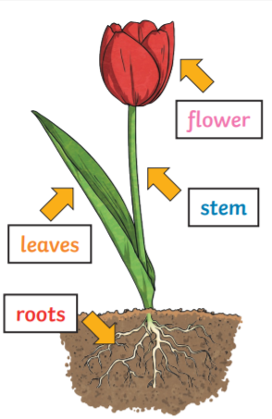
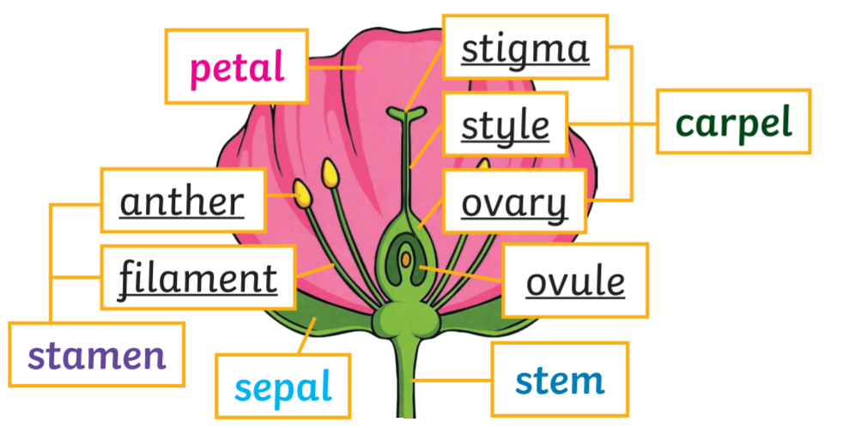
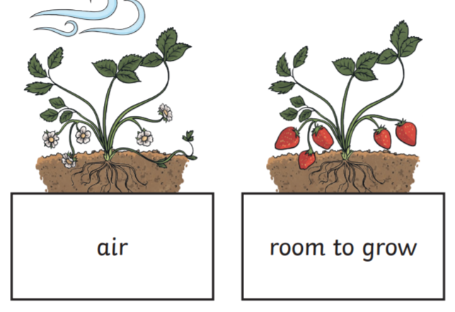
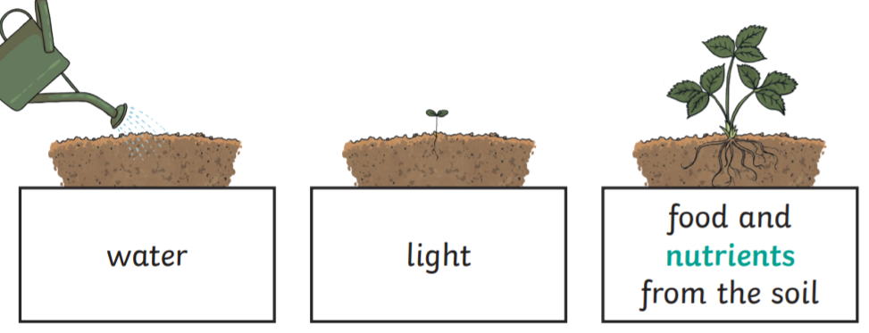
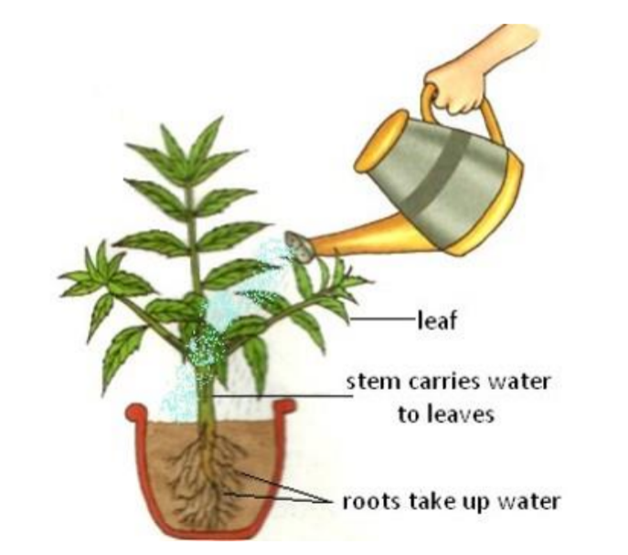
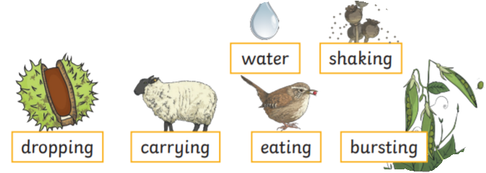
Year 3 Plants
Key Vocabulary
Photosynthesis - the process by which plants use the sun’s energy to make their own food or energy
Pollen – a fine powder produced by flowers which is used to produce new seeds
Pollination – fertilising a plant with pollen, often done by insects.
Plant – a living thing that grows in the Earth and has a stem, leaves and roots
Flower – the part of a plant which is brightly coloured and grows at the end of a stem.
Stem – This holds the plant up and carries water and nutrients from the soil to the leaves. A trunk is the stem of a tree.
Leaves – These make food for the plant using sunlight and carbon dioxide from the air.
Roots – These anchor the plants into the ground and absorb water and nutrients from the ground.
Flowering plant
Each structure in a flowering plant has a job to do.
Flower
The flower’s job is to create seeds so that new plants can be grown.
Parts of a flower vocabulary
What does a plant need to grow?
Different plants vary in how much of these they need. For example, cacti can survive in areas with little water, whereas water lilies need to live in water.
How a plant takes in water
Seed dispersal

