Slide 1
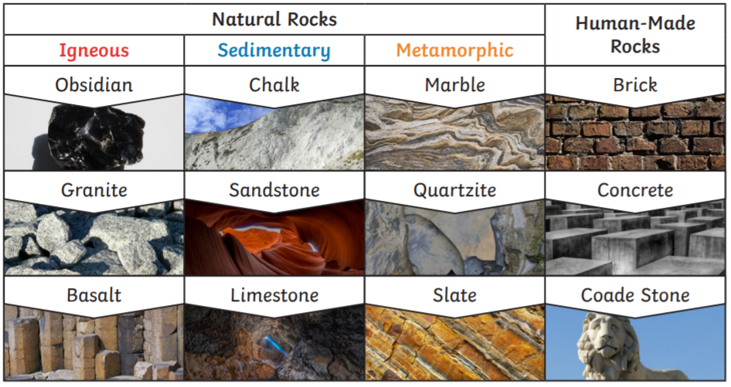
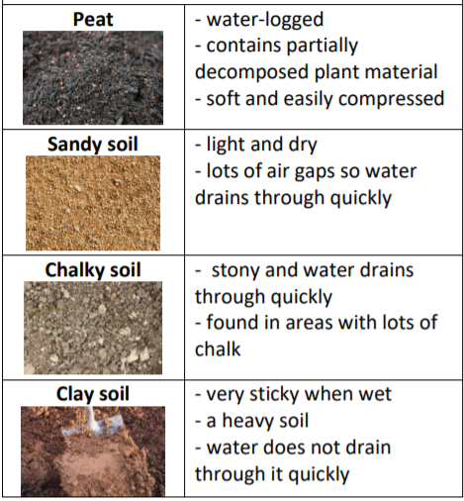
Year 3 Rocks
Key Vocabulary
Rock – made up of grains that are packed together
Fossil – the remains or impressions of a prehistoric plant or animal embedded in rock
Magma – molten rock that remains underground.
Lava – molten rock that comes out of the ground is called lava.
Sediment – natural solid material that is moved and dropped off in a new place by water or wind e.g. sand.
Permeable – allows liquids to pass through it
Impermeable – does not allow liquid to pass through it.
Rocks
IGNEOUS ROCKS - are very hard, dark and heavy. They are formed when molten magma from a volcano cools down. They tend to have interlocking grains giving the rock a crystalline appearance. EXAMPLES: granite, basalt, obsidian.
METAMORPHIC ROCKS - are rocks which have been changed over time by pressure or heat. Fossils can be found in metamorphic rocks if plants and animals have been trapped in the rocks. They are hard but can be damaged by acids. EXAMPLES: slate, marble
SEDIMENTARY ROCKS – are formed by sediment (which includes minerals, small pieces of plants and other organic matter) that is deposited over time. The sediment is compressed over a long period of time before it become solid layers of rock
Soil
The property of soils is affected by the:
type of rock
size of rock pieces
amount of organic matter in it

