Slide 1
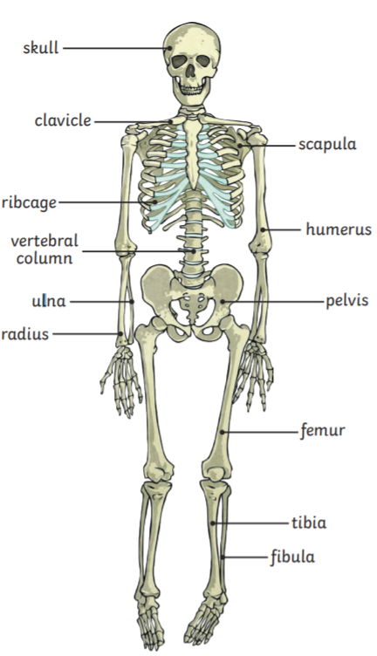
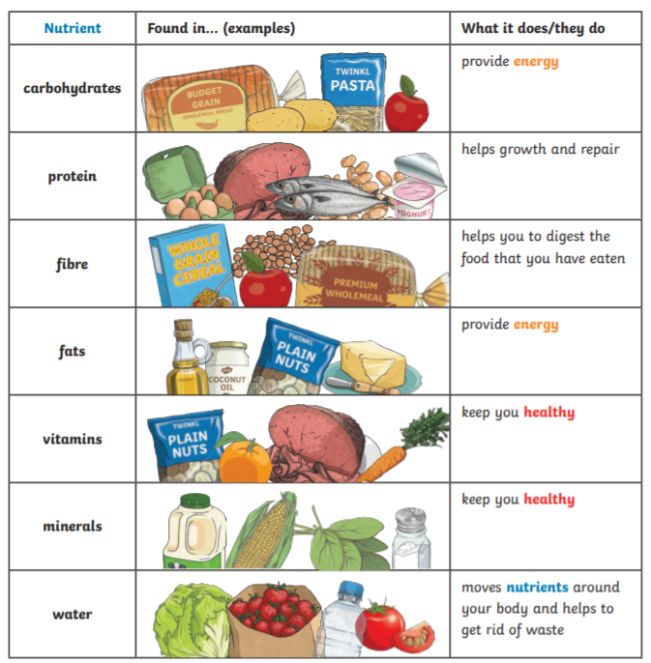
Key Vocabulary
Skeleton – a framework of bones supporting the body.
Muscles – a soft tissue in the body that contracts and relaxes to cause movement of the skeleton.
Joints – a structure in the human or animal body at which two parts of the skeleton are fitted together.
Nutrition – the process of providing or obtaining the food necessary for health and growth.
Minerals – materials found in foods that are essential for growth and health.
Vitamins - substances found in foods that keep you healthy.
Year 3 Animals including humans
BALANCED DIET
Unlike plants, humans do not make their own energy so they need to eat to get energy. In order to be healthy we need to eat a balanced diet with more of some things and less of others
HUMAN SKELETON
The bones in our skeleton provide support so we can stand, move and protect of our organs.

